Slide 1

DEPARTMENT OF COMPUTER SCIENCE AND ENGINEERING
Predictive Analytics For Cyber Threats To Improve Cyber supply Chain Security
under the guidance of
M.MADHUSUDHAN
(Associate professor)
BY
K.GOHATHI (197R1A05L7)
K.SAKETH REDDY (197R1A05L6)
K.PRADEEP (197R1A05M0)

Slide 2
ABSTRACT:
Cyber Supply Chain (CSC) system is complex which involves different sub-systems performing various tasks. Security in supply chain is challenging due to the inherent vulnerabilities and threats from any part of the system which can be exploited at any point within the supply chain. This can cause a severe disruption on the overall business continuity. Therefore, it is paramount important to understand and predicate the threats so that organization can undertake necessary control measures for the supply chain security. This paper aims to analyse and predicate threats to improve cyber supply chain security. We have applied Cyber Threat Intelligence (CTI) with Machine Learning (ML) techniques to analyse and predict the threats based on the CTI properties. That allows to identify the inherent CSC vulnerabilities so that appropriate control actions can be undertaken for the overall cybersecurity improvement. To demonstrate the applicability of our approach, CTI data is gathered and a number of ML algorithms, i.e., Logistic Regression (LG), Support Vector Machine (SVM), Random Forest (RF), and Decision Tree (DT), are used to develop predictive analytics using the Microsoft Malware Prediction dataset. The experiment considers attack and TTP as input parameters and vulnerabilities and Indicators of compromise (IoC) as output parameters. The results relating to the prediction reveal that Spyware/Ransomware and spear phishing are the most predictable threats in CSC. We have also recommended relevant controls to tackle these threats. We advocate using CTI data for the ML predicate model for the overall CSC cyber security improvement.

Slide 3
EXISTING SYSTEM:
A recent NCSC report highlights a list of CSC attacks by exploiting vulnerabilities that exist within the systems. Organizations outsource part of their business and data to the thirdparty service providers that could lead any potential threat. There are several examples for successful CSC attacks. For instance, Dragonfly, a Cyber Espionage group, is well known for targeting CSC organization. The Saudi Aramco power station attack halted its operation due to a massive cyberattack. There are existing works that consider CSC threats and risks but a lack of focus on threat intelligence properties for the overall cyber security improvement.
DISADVANTAGES
• Those attacks on the cyber physical and cyber digital system components such as distributed denial of service (DDoS) attacks, IP address spoofing, and Software errors.
• The data is loss in the company server due to malware attack

Slide 4
PROPOSED SYSTEM:
Firstly, we consider Cyber Threat Intelligence(CTI) for systematic gathering and analysis of information about the threat actor and cyber-attack by using various concepts such as threat actor skill, motivation, IoC, TTP and incidents. The reason for considering CTI is that it provides evidence-based knowledge relating to the known attacks. This information is further used to discover unknown attacks so that threats can be well understood and mitigated. CTI provides intelligence information with the aim of preventing attacks as well as shorten time to discover new attacks.
ADVANTAGES
• Our prediction reveals a total accuracy of 85% for the TPR and FPR
• The results also indicate that LG and SVM produced the highest accuracy in terms of threat predication.
• Greater efficiency.

Slide 5
HARDWARE REQUIREMENTS:
• Operating system : windows, linux
• Processor : minimum intel i3
• Ram : minimum 4 gb
• Hard disk : minimum 250gb

Slide 6
SOFTWARE REQUIREMENTS:
Python idel 3.7 version (or)
Anaconda 3.7 ( or)
Jupiter (or)
Google colab

Slide 7
NOVELTY
The novelty of this project is , Due to the invincibility nature of cyber attacks on the cyber supply chain (CSC), and the cascading effects of malware infections, we use machine learning to predict attacks. As organizations have become more reliant on CSC systems for business continuity, so are the increase in vulnerabilities and the threat landscapes. Some traditional approach to detecting and defending malware attack has largely been antimalware or antivirus software such as spam filters, firewall, and IDS/IPS.In this project, we use ML techniques to learn the dataset and predict which CSC nodes have detection or no detection. The purpose is to predict which modes are venerable to cyberattacks and for predicting future trends. To demonstrate the applicability of our approach, we used a dataset from the Microsoft Malware Prediction website. Further, an ensemble is used to link Logistic Regression, and Decision Tree and SVM algorithms in Majority Voting and run on the training data and then use 10-fold cross validation to test the parameter estimation, accurate results and predictions. The results show that ML algorithms in Decision Trees methods can be used in cyber supply chain predict analytics to detect and predict future cyber attack trends.

Slide 8
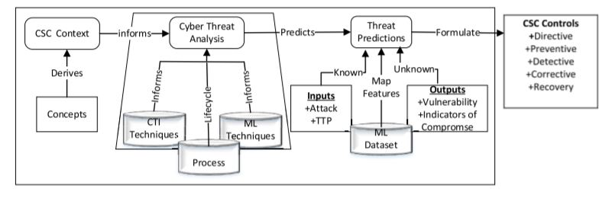
ARCHITECTURE
.

Slide 9
MODULE :
Here are the major modules
1. User login.
2. Take the input from the user.
3. Analyze the users request.
4. we used a dataset from the Microsoft Malware Prediction website
5. Identification of threat.
6. answer to the user.

Slide 10
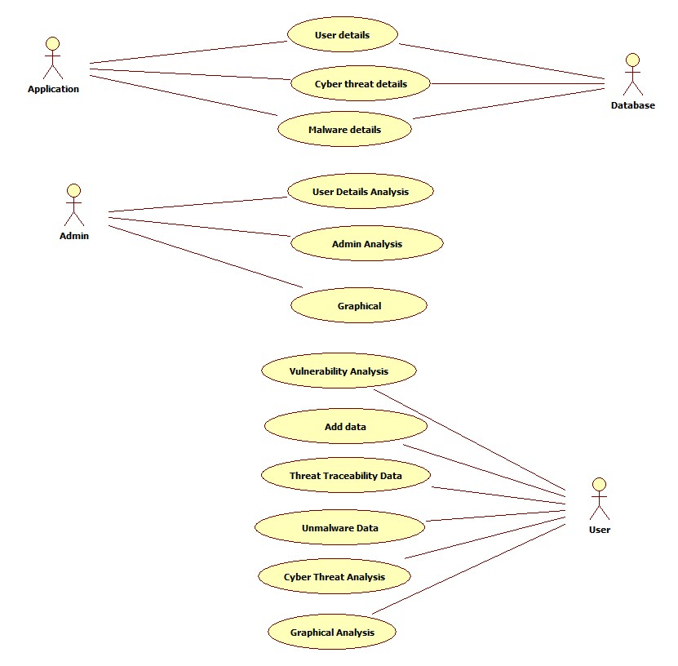
Use Case Diagram

Slide 11
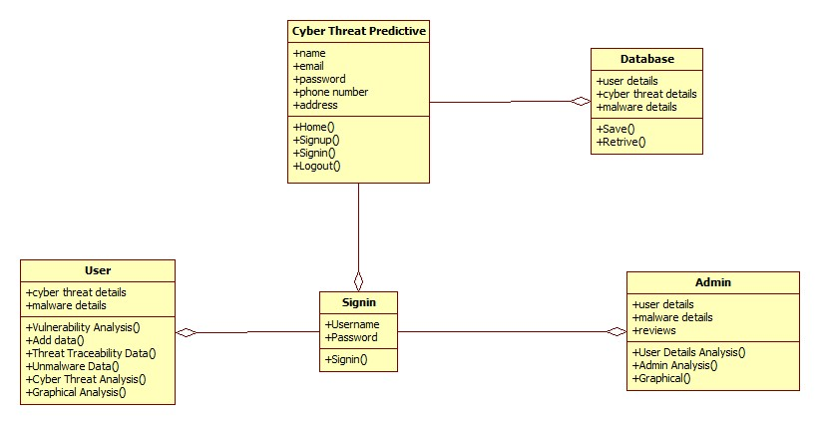
Class Diagram

Slide 12
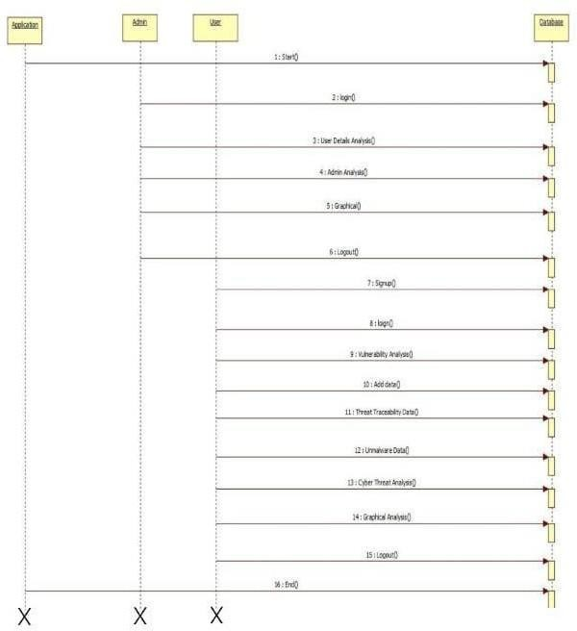
Sequence Diagram

Slide 13
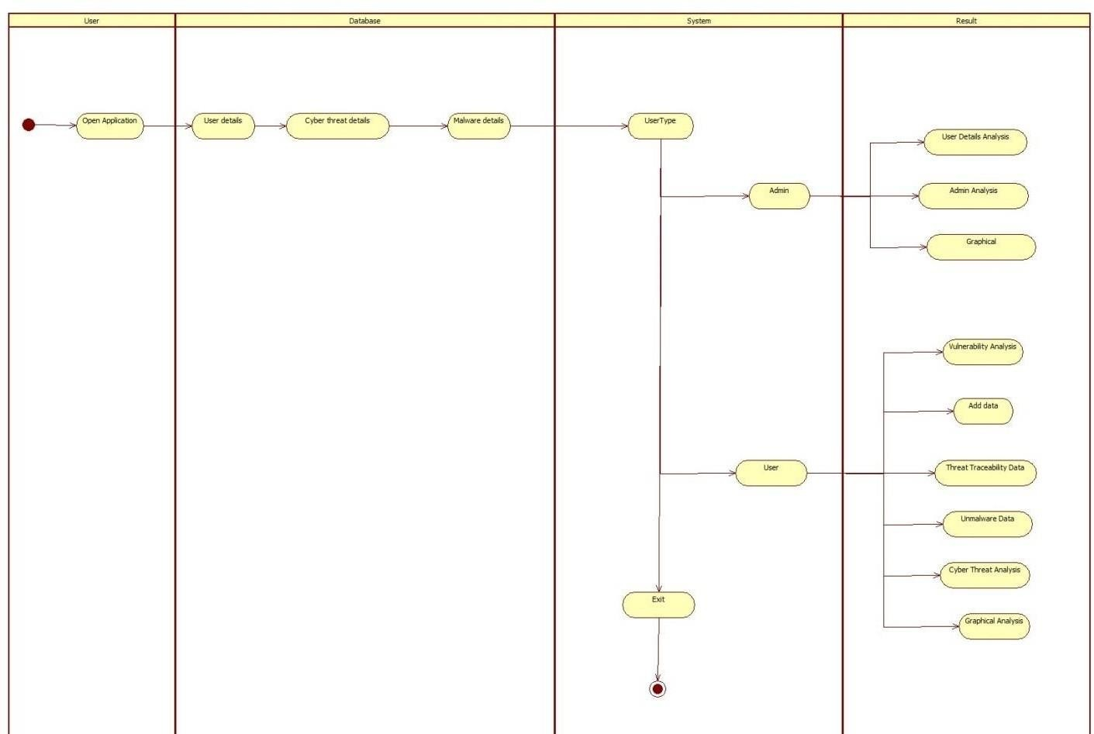
Activity Diagram

Slide 14
SAMPLE CODE
#!/usr/bin/env python
import os
import sys
if __name__ == "__main__":
os.environ.setdefault("DJANGO_SETTINGS_MODULE", "Cyber_Hacking_Breaches.settings")
try:
from django.core.management import execute_from_command_line
except ImportError as exc:
raise ImportError(
"Couldn't import Django. Are you sure it's installed and "
"available on your PYTHONPATH environment variable? Did you "
"forget to activate a virtual environment?"
) from exc
execute_from_command_line(sys.argv)

Slide 15
import win32gui
import win32ui
from ctypes import windll
import Image
hwnd = win32gui.FindWindow(None, 'Calculator')
# Change the line below depending on whether you want the whole window
# or just the client area.
#left, top, right, bot = win32gui.GetClientRect(hwnd)
left, top, right, bot = win32gui.GetWindowRect(hwnd)
w = right - left
h = bot - top
hwndDC = win32gui.GetWindowDC(hwnd)
mfcDC = win32ui.CreateDCFromHandle(hwndDC)
saveDC = mfcDC.CreateCompatibleDC()

Slide 16
saveBitMap.CreateCompatibleBitmap(mfcDC, w, h)
saveDC.SelectObject(saveBitMap)
# Change the line below depending on whether you want the whole window
# or just the clientsaveBitMap = win32ui.CreateBitmap()
area.
#result = windll.user32.PrintWindow(hwnd, saveDC.GetSafeHdc(), 1)
result = windll.user32.PrintWindow(hwnd, saveDC.GetSafeHdc(), 0)
print result
bmpinfo = saveBitMap.GetInfo()
bmpstr = saveBitMap.GetBitmapBits(True)
im = Image.frombuffer(
'RGB',
(bmpinfo['bmWidth'], bmpinfo['bmHeight']),
bmpstr, 'raw', 'BGRX', 0, 1)

Slide 17
win32gui.DeleteObject(saveBitMap.GetHandle())
saveDC.DeleteDC()
mfcDC.DeleteDC()
win32gui.ReleaseDC(hwnd, hwndDC)
if result == 1:
#PrintWindow Succeeded
im.save("test.png")

Slide 18
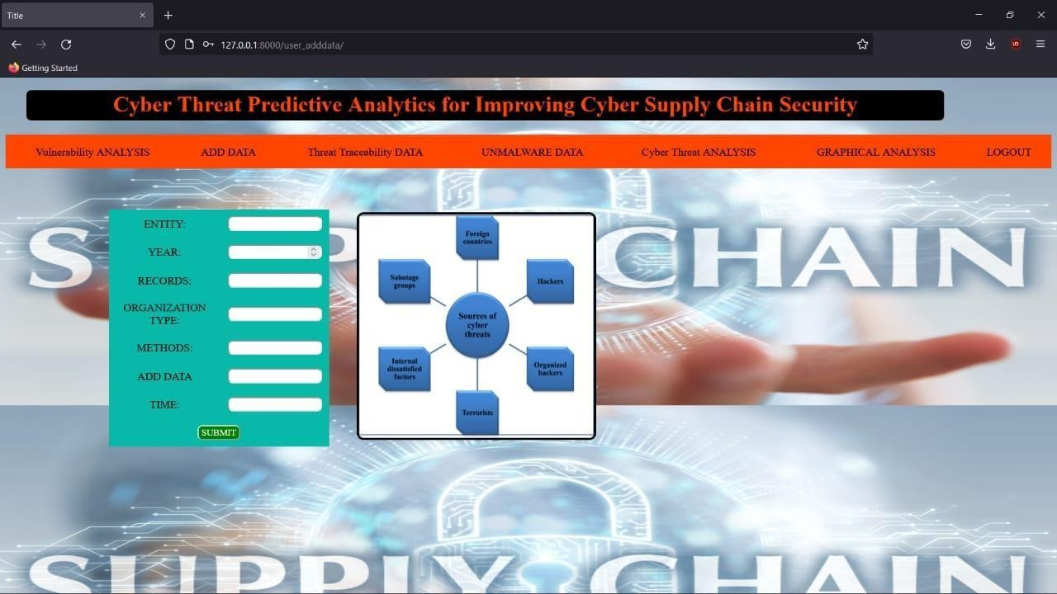
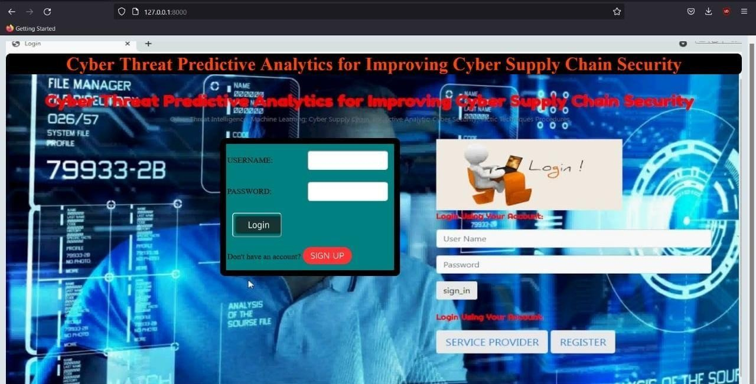
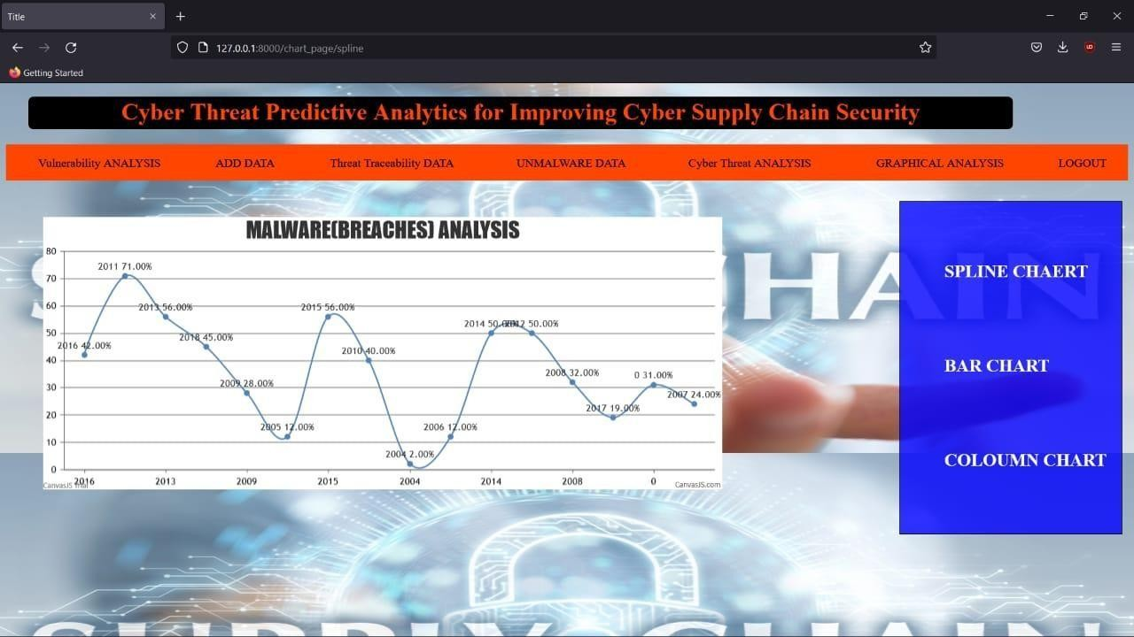
RESULTS:
Vulnerability Analysis
Login screen
Spline Chart

Slide 19
CONCLUSION:
The integration of complex cyber physical infrastructures and applications in a CSC environment have brought economic, business, and societal impact for both national and global context in the areas of Transport, Energy, Healthcare, Manufacturing, and Communication. However, CPS security remains a challenge as vulnerability from any part of the system can pose risk within the overall supply chain context. This paper aims to improve CSC security by integrating CTI and ML for the threat analysis and predication. We considered the necessary concepts from CSC and CTI and a systematic process to analyse and predicate the threat.

Slide 20
THANK YOU

